Slide 1
HYPER TEXT TRANSFER PROTOCOL

Slide 2
HTTP
The Hypertext Transfer Protocol (HTTP) is a protocol used mainly to access data on the World Wide Web. HTTP functions like a combination of FTP and SMTP . It is similar to FTP because it transfers files and uses the services of TCP. However, it is much simpler than FTP because it uses only one TCP connection.
There is no separate control connection; only data are transferred between the client and the server. HTTP is like SMTP because the data transferred between the client and the server look like SMTP messages.
In addition, the format of the messages is controlled by MIME-like headers. Unlike SMTP, the HTTP messages are not destined to be read by humans; they are read and interpreted by the HTTP server and HTTP client (browser).
SMTP messages are stored and forwarded, but HTTP messages are delivered immediately. The commands from the client to the server are embedded in a request message. The contents of the requested file or other information are embedded in a response message. HTTP uses the services of TCP on well-known port 80.

Slide 3
HTTP TRANSACTION:
HTTP Transaction illustrates the HTTP transaction between the client and server. Although HTTP uses the services of TCP, HTTP itself is a stateless protocol, which means that the server does not keep information about the client. The client initializes the transaction by sending a request. The server replies by sending a response.
Request Message :
A request message consists of a request line, a header, and sometimes a body.
REQUEST LINE:
Request Line The first line in a request message is called a request line. There are three fields in this line separated by some character delimiter .The fields are called methods, URL, and Version. These three should be separated by a space character. At the end two characters, a carriage return followed by a line feed, terminate the line.

Slide 4
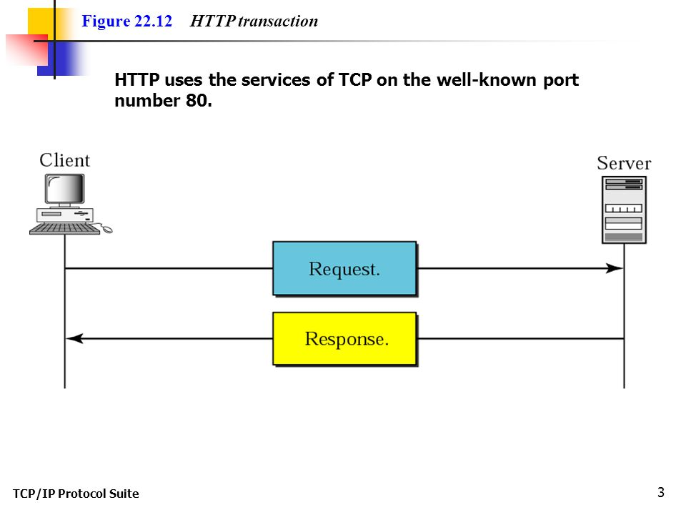

Slide 5
METHODS
The Method Field Defines the Request Type.In HTTP Serval Methods are Defines which is shown below.
GET : Requests a document from the server.
HEAD : Requests information about a document but not the document itself .
POST :Sends some information from the client to the server.

Slide 6
HEADER LINES IN REQUEST MESSAGE
After the request line, we can have zero or more request header lines. Each header line sends additional information from the client to the server. For example, the client can request that the document be sent in a special format. Each header line has a header name, a colon, a space, and a header value.
We will show some header lines in the examples at the end of this chapter. It some header names commonly used in a request. The value field defines the values associated with each header name. The list of values can be found in the corresponding RFCs

Slide 7
Response Message
A response message consists of a status line, header lines, a blank line and sometimes a body.
Header Lines In Response Message
After the status line, we can have zero or more response header lines. Each header line sends additional information from the server to the client. For example, the sender can send extra information about the document

Slide 8
THANK YOU

